Slide 1




Digital Gourde Mobile
Tutors :
Gabriel MOPOLO-MOKE
Alexandre MAISONOBE
Gaëtan LESCOUFLAIR
Notes:
This project consists of the creation of a social cryptocurrency; virtual exchange currency, secure to facilitate and revolutionize the payment and the transfer of money. It mainly considers those who are unbanked of the Haitian population. This currency could be used in several sectors such as agriculture, education, health, etc.
A technology called blockchain which, by its intrinsic properties, brings a facility and rapidity of the exchanges, security of the transactions and an environment of confidence, will be the base of our medium of exchange.
Indeed, the blockchain is a replicated database, decentralized so there is no central authority. Once a transaction is validated, it cannot be erased and any attempt to falsify is rendered extremely complex. In addition, there is the anonymity of the users realized by the cryptography.
The created blockchain will be private because the transactions will be verified and validated by those who can connect to the blockchain. This allows for greater efficiency, scalability, low energy consumption. Moreover, transactions on a private blockchain are validated much more quickly.
In this part of the project, we are dedicated to the implementation of the mobile application. It gives us the possibility of including functionalities such as reading QR Code or even using NFC.

Slide 2

Notes:
This project consists of a partnership between the university and the republic bank of Haiti called BRH.

Slide 3

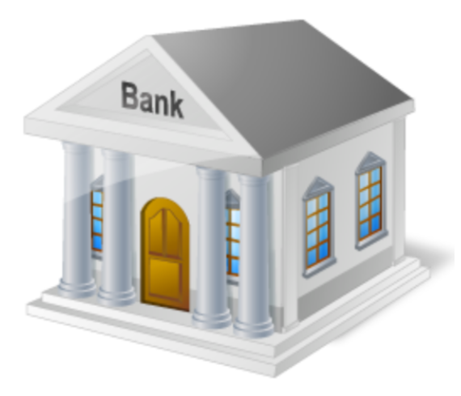
Notes:
Which is the main client here. The main will be to set up a state’s cryptocurrency of the same name to be managed, supervised

Slide 4
Notes:
distributed by the BRH and made available to local financial institutions.

Slide 5
01
Reduce and then eliminate the cost of manufacturing and importing physical currency
02
Enable Haiti's unbanked people to be, without risk to financial institutions
Notes:
The long-term objectives of the project are: Firstly, to reduce and then eliminate the cost of manufacturing and importing physical currency
Then to enable Haitian’s non-banked people to be safe, without risk to financial institutions
The major advantage of using cryptocurrencies in a case such as this is that the creation of money is instantaneous and free of charge. Also, each transaction using this currency (distribution, payment, transfer, etc.) will have an extremely low cost and will be instantaneous since the blockchain on which it is based uses a client-server architecture rather than a Proof of Work, unlike cryptocurrencies such as Bitcoin or Ethereum.

Slide 6
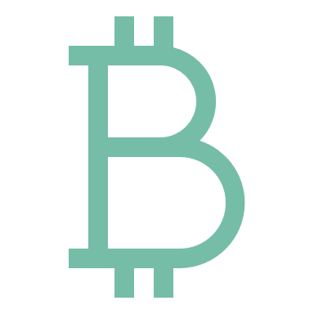

CHAIN
T R A N S A C T I O N
O P E N – S O U R C E
6
Notes:
Openchain is an open source blockchain technology, or rather transaction chain. Indeed, Openchain does not use the concept of block like blockchains such as bitcoin, transactions are directly grouped between them and not via blocks. This saves time and transactions are validated in (almost) real time.

Slide 7
2
1
1
Instant transaction validation
3
2
No mining fees
7
Openchain
3
Secured via digital signature
4
Transparency of transactions
4
5
Managing the loss or theft of private keys
6
5
6
Several possible Openchain instances
7
Hierarchy system
Notes:
Openchain has many features: Instant transaction validation No mining fees Secured via digital signatures Transparency of transactions Managing the loss or theft of private keys for end-users Opportunity to have multiple Openchain instances Hierarchy system

Slide 8
Levels of control
1
Central Administrator
2
Intermediate Director
1
2
3
3
Anonymous users
Notes:
And then Openchain has also Several levels of control: A fully open register that can be reached anonymously Participants must be approved by the administrator Some users enjoy more rights than anonymous users

Slide 9

The Actors
Financial institutions
BRH
Private individuals
Shopkeepers
Controls the blockchain Creates money Distributes change
Manages its customers Management of services offered to its customers
Manages your account Payments/Transfers
Manages your account Payments/Transfers
Notes:
This application brings together 4 major actors.
BRH administrator: They are the biggest administrators. They are the ones who make the first transactions and determine the number of cryptocurrencies in circulation with the agreement of the BRH.
Financial Institutions Administrator: person responsible for configuring the system and distributing access rights to the validating body over which he controls.
Private individuals and Shopkeepers: person who uses the system to carry out transactions

Slide 10
The constraints
Notes:
For this project we have some constraints to better reflect reality.
The application must be scalable and easily usable by any user, so it must meet certain specifications.
In addition, certain logic rules must be introduced into the development process to respect the classic functioning of a bank.
We assume that the owner of the application is the BRH
All operations must be subject to verification.
The balance of a wallet cannot be negative:
- The central bank cannot distribute to financial institutions more than the remaining amount issued in electronic gourde available in its wallet
- A financial institution cannot distribute to its customers more than what it has in its wallet
- An individual or trader cannot transfer or withdraw more than what they have in their wallet
The central bank may at any time issue a new electronic currency
Whatever the operation, we always debit a wallet to credit another wallet
A wallet is always attached to a bank.

Slide 11

01
Learning
Conclusion
02
Limits
03
Proof of Concept
Notes:
This project allowed us to discover some of the blockchain technology that we were not necessarily aware of, and which is much more feasible in banking. The main objective of the project was to create a prototype social cryptocurrency that would allow people who were not banked to do so. But also, to reduce the costs of creating money.
The application features are as follows: Web section for each profile: Create an account and connect Perform transactions (transfers, payments, etc.) Manage your personal account Web part for BRH: Manage authorizations Create money Mobile part:
Same functionality as the web part QR Code reads (mobile payment) The current state of the application is sufficient to make it a Proof Of Concept, however it is possible to expand the infrastructure on a larger scale (distinct areas So we have a web application with access for each profile and a mobile version with the main specificity of reading QR code for mobile payment.

